Slide 1
IOTrix 2025 Final Round
Piyal's Zero-Token Crisis
A Tokenless Dining Management System Challenge

Slide 2
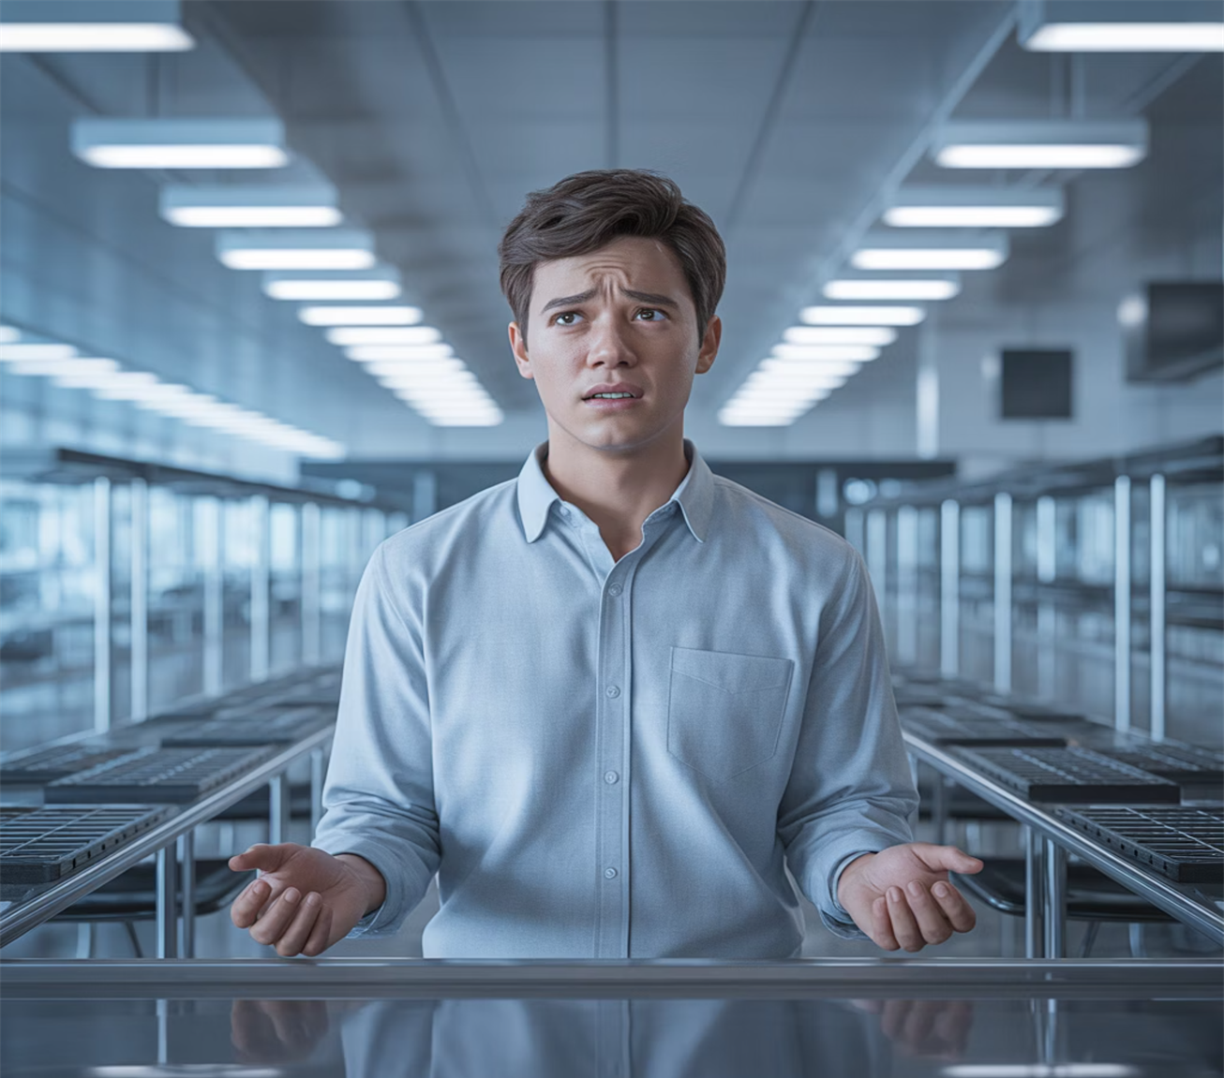
The Crisis Unfolds
Piyal Chakraborty, a software engineering student, rushes to the cafeteria after being mugged. The thugs took everything: wallet, phone, ID card, and his dining token.
Standing at the entrance with no credentials and an empty stomach, he faces Jigar Alam, the new cafeteria manager who has strict orders: no token, no food.

Slide 3
Piyal’s Dilemma
Piyal’s dilemma is one of being stuck between security measures (no token, no food) and the need for flexibility (he’s in an exceptional situation).
The system must balance strict rules with empathy and quick solutions, ensuring both efficiency and fairness in a cafeteria environment.

Slide 4
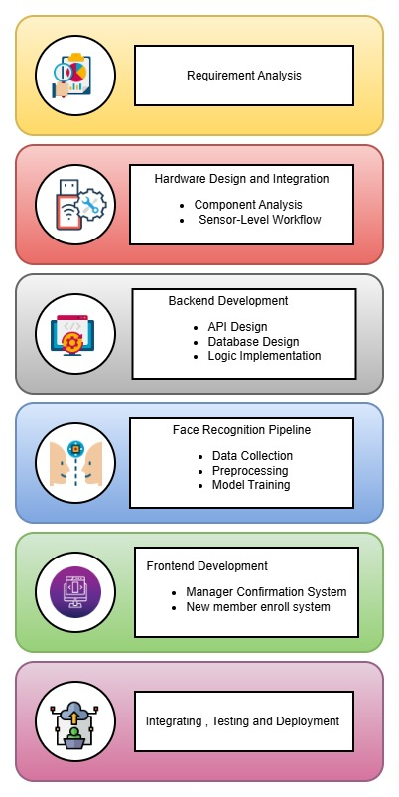
Methodology

Slide 5
01
Requirement Analysis

Slide 6
02
Hardware Design and Integration

Slide 7
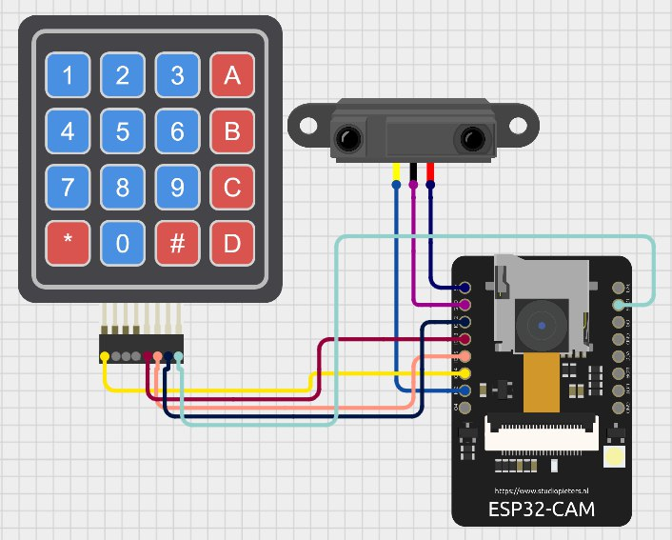
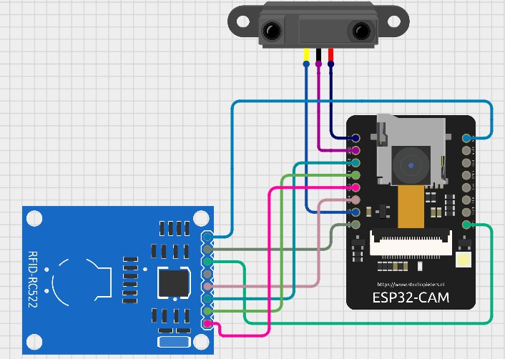
Circuit Diagram

Slide 8
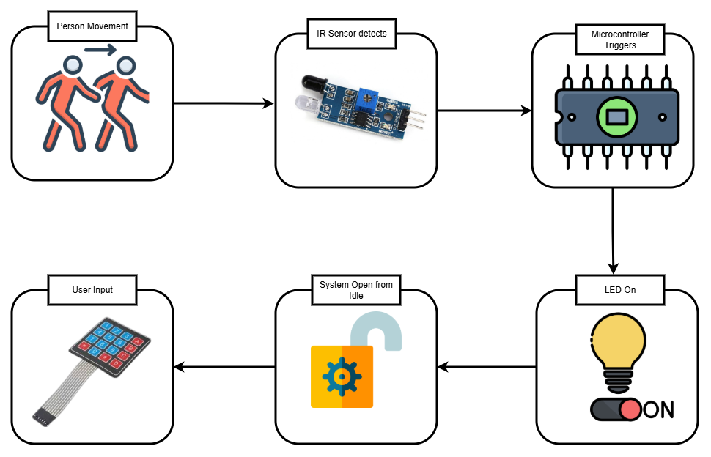
Sensor Workflow

Slide 9
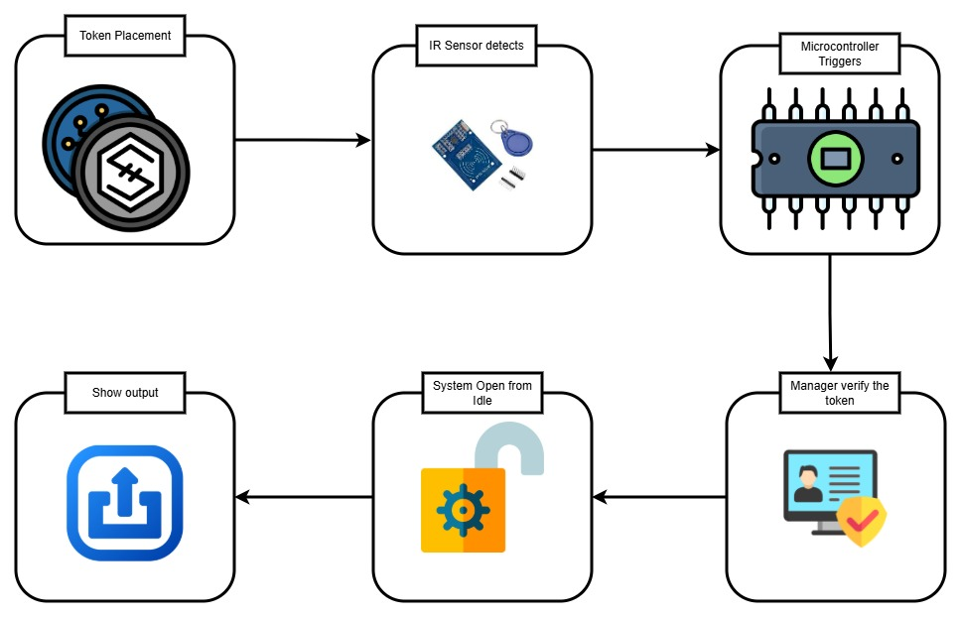
Sensor Workflow

Slide 10
03
Backend Development

Slide 11
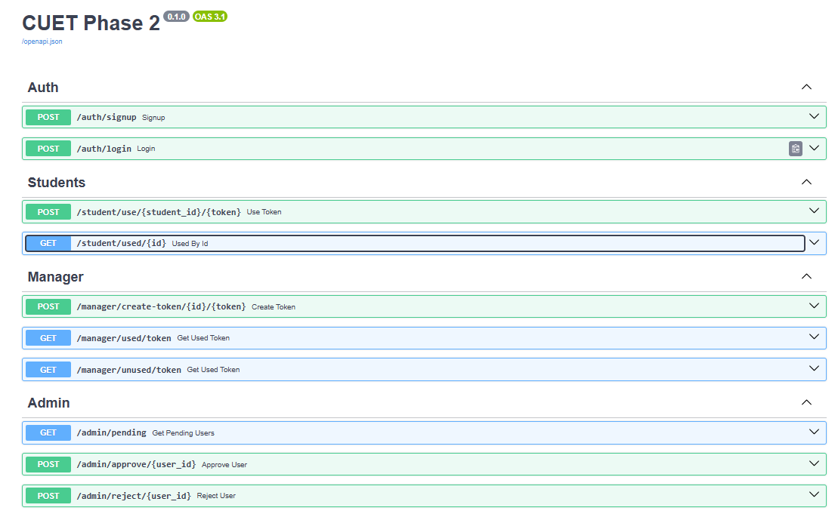
API Docs

Slide 12
03
User Guide

Slide 13
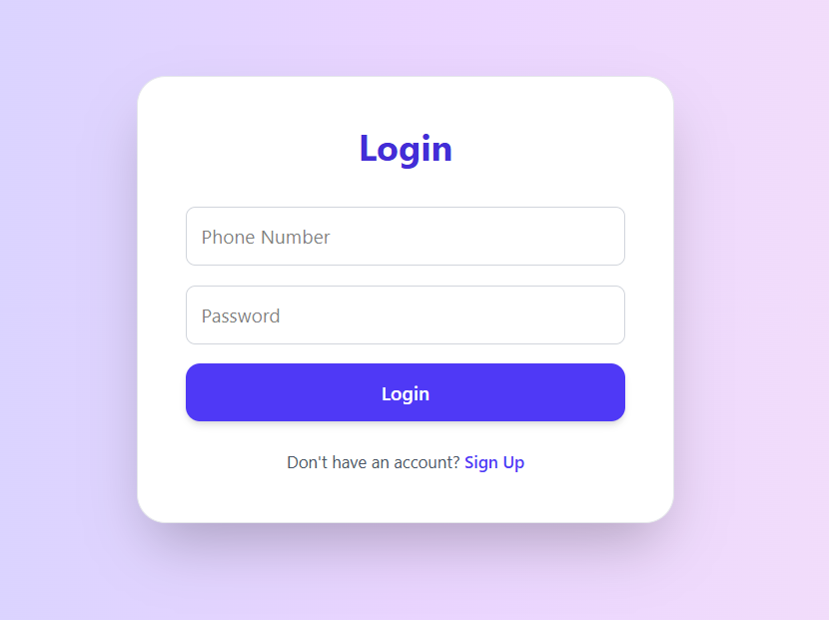
Login

Slide 14
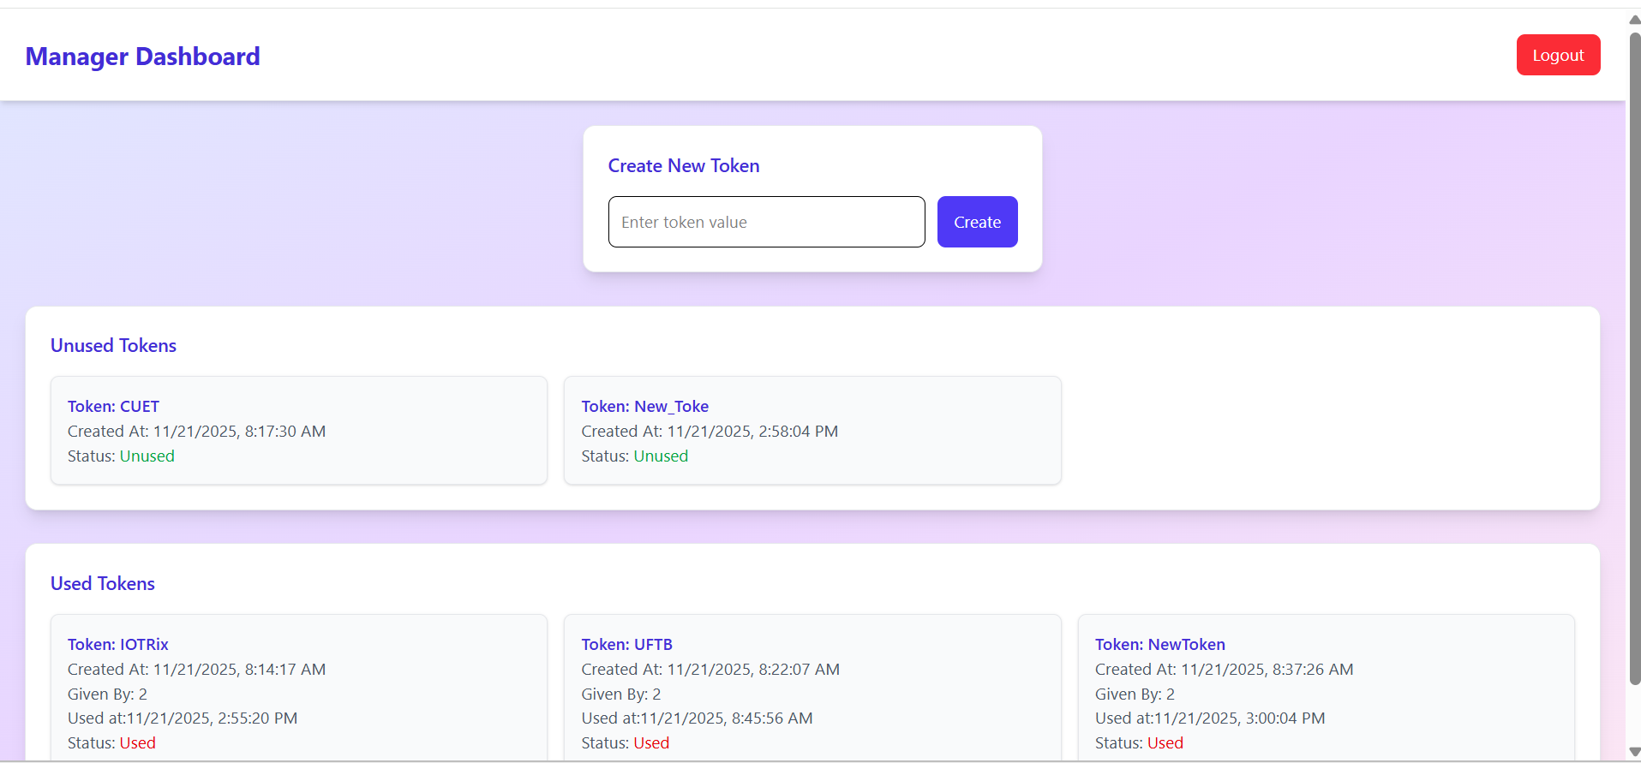
Manager

Slide 15
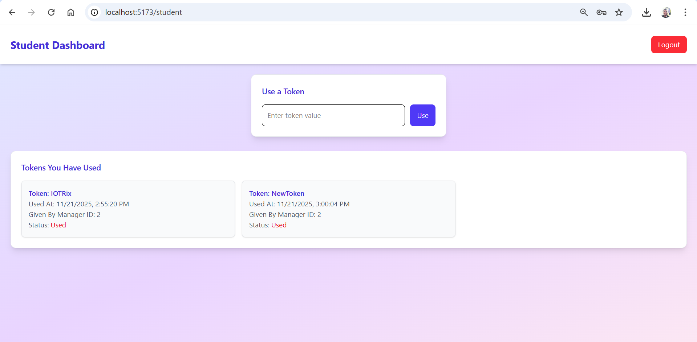
Student

Slide 16
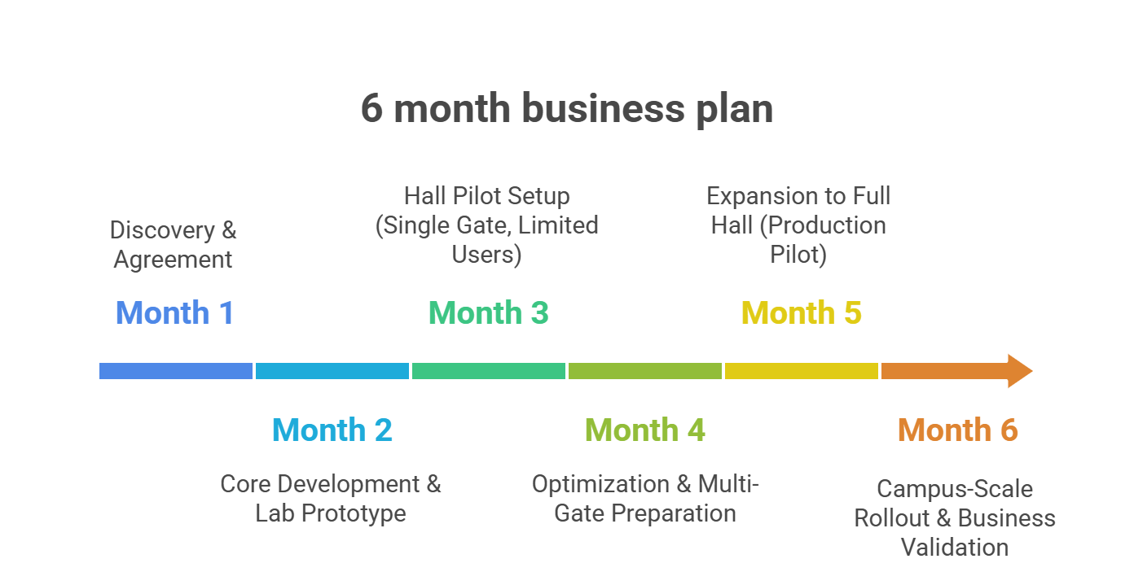
Business Cycle

Slide 17
Business Budget for one time setup
Item | Qty | Cost/Unit (BDT) | Subtotal (BDT)
Smart Gate Hardware (ESP32-CAM + IR + wiring, etc.) | 3 gates | 2,500 | 7,500
Local mini-PC / Used Desktop (runs backend + recognition) | 1 | 25,000 | 25,000
Network equipment (switch, LAN cables, mounts) | 1 set | 10,000 | 10,000
Small UPS for server + network | 1 | 8,000 | 8,000
Misc. fabrication (stands, boxes, labels, tools) | – | 5,000 | 5,000
Hardware subtotal |  |  | 55,500
Contingency (~10%) | – | – | 5,500
Total One-Time Setup (1 Hall) |  |  | ≈ 61,000 BDT

Slide 18
Data Security, Privacy
Category | Measures (Short & Precise)
Data Security | • Encrypted database & hashed passwords• HTTPS communication• Role-based access control• Full activity logs
Privacy | • No video stored• Only face embeddings saved• Minimal student data collected• All processing stays inside CUET network
Anti-Fraud | • Face + RFID + PIN triple verification• One-meal-per-slot lock• Anti-tailgating IR sensors• Spoof protection (blink/motion)• Suspicious activity auto-flagging

Slide 19

Conclusion
This is not a dining system.
This is the future of identity-driven campus automation.
And today, Piyal is the first person who will never lose his food again.”

